Slide 1
Welcome to the Web Application Development with Python L-4 Training Program

Slide 2
MD. SHAKIL
NSDA Certified Trainer & Assessor
Vendor Certified
IT Specialist in Python
Sr. Backend Developer
Ethical Den
Asst. Trainer
Daffodil International Professional Training Institute
Lead Trainer
eShikhon IT Training Institute
Lead Trainer
Wizard Software & Technology
+88 01793-299882
shakil.eub.cse@gmail.com
https://www.linkedin.com/in/mrshakil015
https://mrshakil.com

Slide 3
Lecture
Python List
08

Slide 4
Python List
A list is a built-in data structure in Python that allows you to store multiple items in a single variable.
Lists are ordered
mutable (can be changed)
allow duplicate values.
Lists are created using square brackets:
studentlist = [“rohim”, 100, True, “Korim”, 5.5]

Slide 5
Why Use Lists?
Lists are used to:
Store multiple values in a single variable
Access elements using index
Modify, add, or remove elements
Perform operations on collections of data

Slide 6
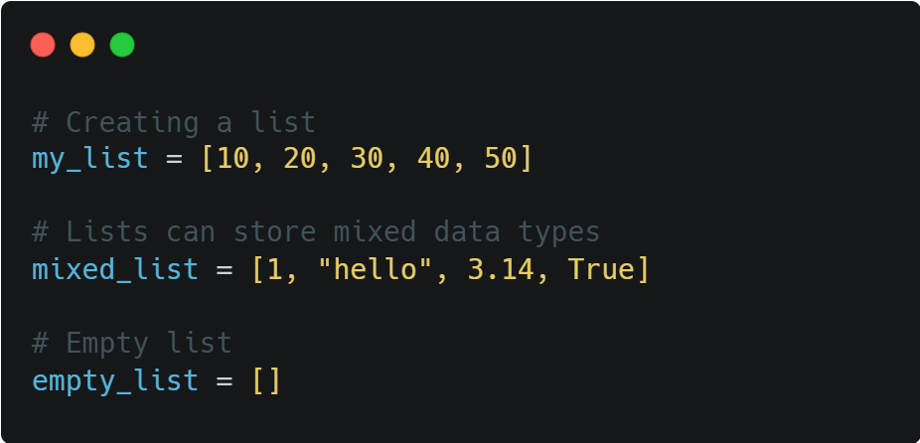
Creating a List
Lists are created using square brackets [ ].

Slide 7

Access List Element
List elements are accessed using index numbers (starting from 0). The index of first item is 0, the index of second item is 1, and so on.

Slide 8
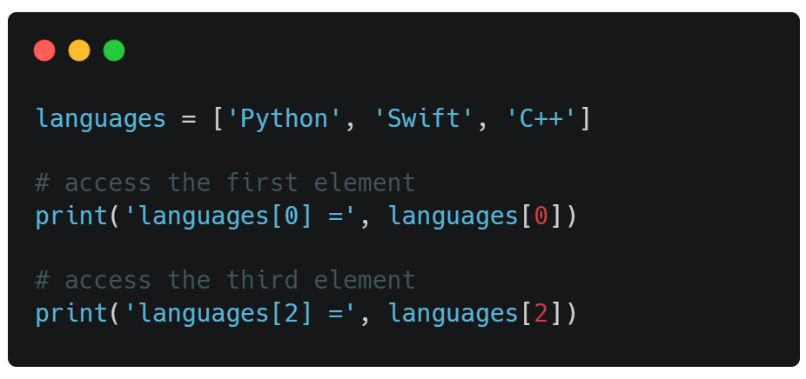

Access List Element

Slide 9
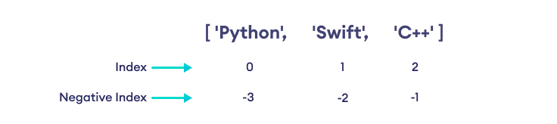
Negative Indexing
In Python, a list can also have negative indices. The index of the last element is -1, the second last element is -2 and so on.

Slide 10
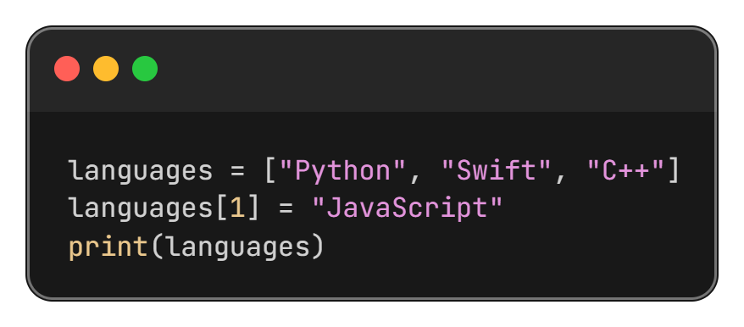
Changing List Items
Lists are mutable, so values can be changed.

Slide 11
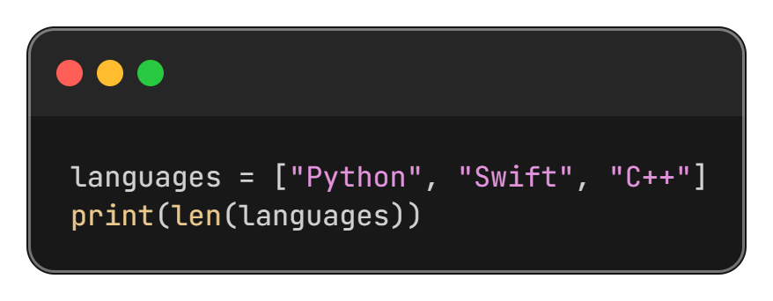
List Length
Use the len() function to find the number of elements

Slide 12
Adding Elements to a List

Slide 13
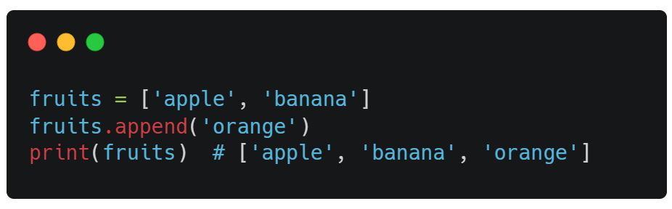
append(item) Method
Adds a single item to the end of the list

Slide 14
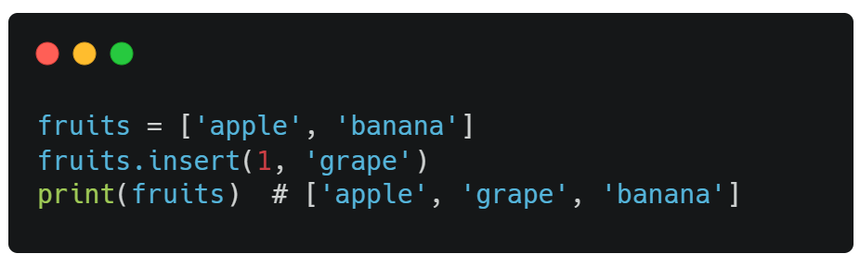
insert(index, item) Method
Inserts an item at the specified index

Slide 15
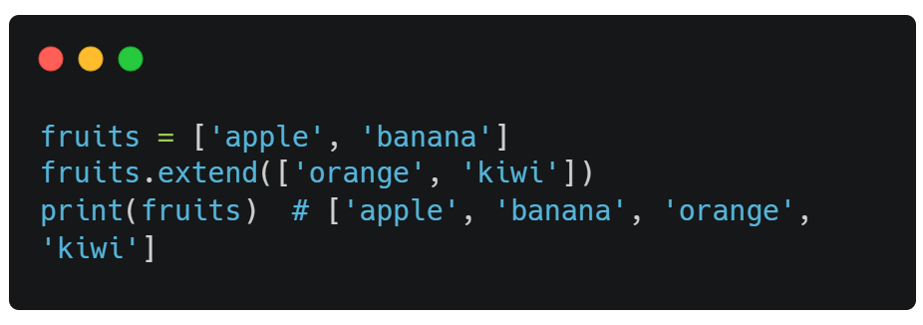
extend(list) Method
Add the element of a list to the end of the current list

Slide 16
Removing Elements from a List

Slide 17
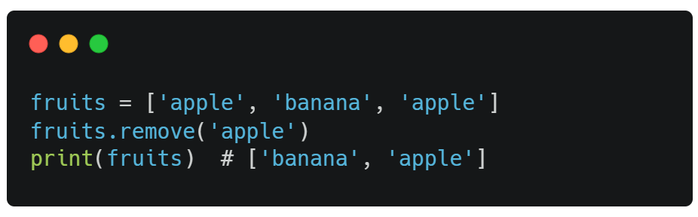
remove(item) Method
Removes the first occurrence of a value

Slide 18
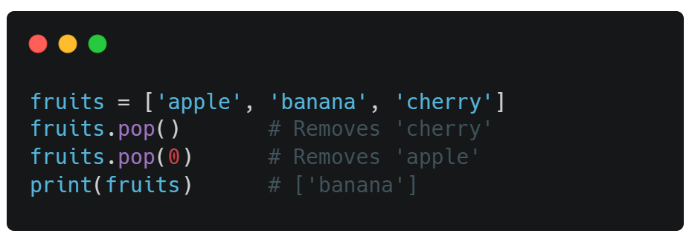
pop([index]) Method
Removes the element at the specified position
Note: If we not provide index it’s remove the last element

Slide 19
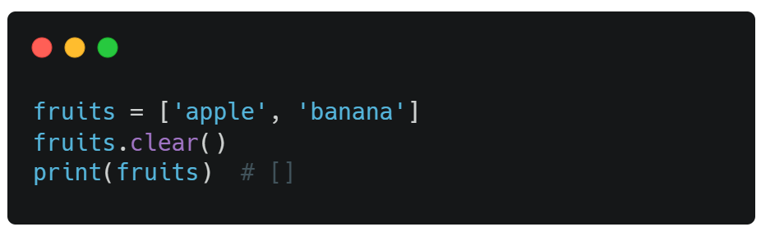
clear() Method
Removes all items from the list.

Slide 20
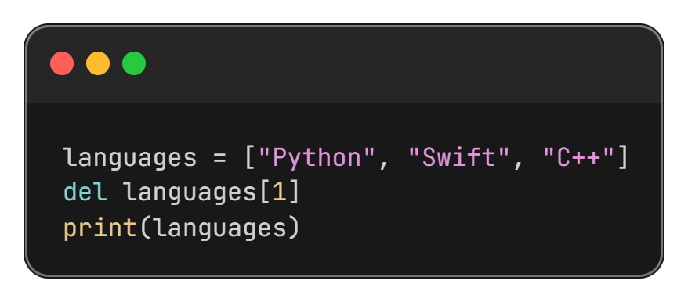
del Keyword
Remove specific index or a variable.

Slide 21
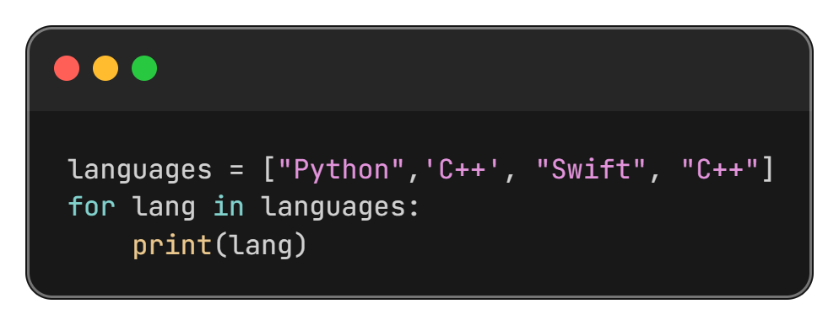
Using for Loop

Slide 22
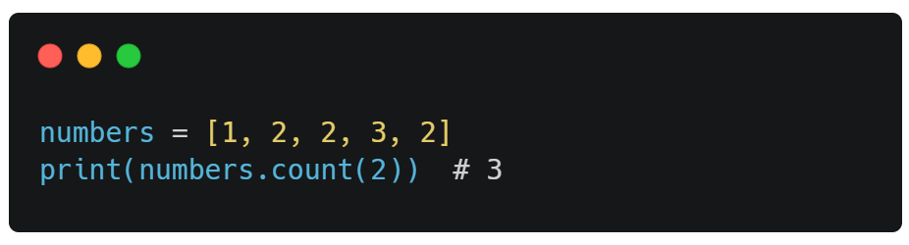
count() Method
Returns the number of elements with the specified value.

Slide 23
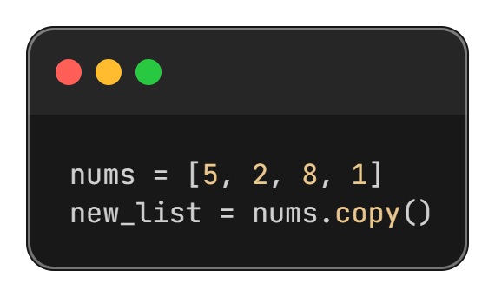
copy() method
Duplicate or copy a list using this method.

Slide 24
Thanks All

